Slide 1
Album cover analysis
With album covers coming from the Pop genre

Slide 2
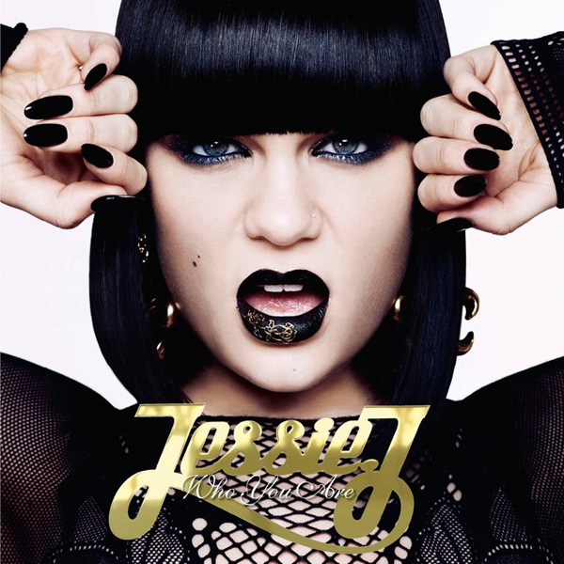
Jessie J – Who You Are
This album cover for Jessie J who you are shows a close up of her face, with her hands either side, giving the consumer the impression she is trying to break out. Her mouth is also open, showing some of her teeth, this gives her a very serious expression. When it comes to mise en scene, her black hair cut perfectly straight with a bold fridge coming just above her eyes, this stands out dramatically compared to her very pale skin, this makes her look very rebellious compared to other artists of this same genre. Her make up, nails and clothing are also the same black colour, with hints of gold seen on her lips and earrings. The use of fish net and wide open lace, gives Jessie J a very rocky look, something which isn’t typical of the pop genre. Her eye make up in particular makes her eyes look very piercing and dark, giving the impression that she is looking right through you. This engages the consumer, making it more personal. This very dark make up gives Jessie J a very edgy look, giving the consumer the impression that her music might also be in this type of setting as well. The bright lighting used to create the white background, also emphasises Jessie J’s pale skin and heavy black make up.
The gold writing stands out dramatically on the black of her outfit. This writing is very similar to heavy gold chain necklaces which rappers tend to wear, once again portraying this edgy rock style. The gold is also very a very typical colour pairing with black, and editing would have been used to make the gold shiny, giving the impression that it is a necklace hanging around her neck. The font is also sans serif which stands out a lot more compared to regular serif fonts, this makes it eye catching when sitting on a shelf, enhanced also with the bold make up and clothing choices.
This album cover also has a very untypical line of focus. For example the title is actually at the bottom of the album, compared to at the top left or centre which is where we would typically expect it to be, because this is where a persons line of vision typically starts, then progresses downwards diagonally.
This album cover can be linked a lot to Fowlers theory that ‘there are many sub genres for which we still have no name’. I linked it to this theory because this album cover looks as though it does not typically fit into the ‘pop’ genre and could be classed as something more such as ‘pop rock’, which has a slightly more edgier sound and concept to it.

Slide 3
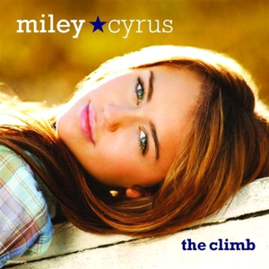
Miley Cyrus – The climb
This is a very typically album cover for a pop/country genre album. When it comes to lighting and editing, you can see that top lighting is used to create the sense of natural sunlight beaming down along the top side of Mileys face and hair. This use of top lighting can be used to show her innocence, giving her a pure look, compared a lot to her style of music at this time. There is also editing used to blur the yellow background, which we can assume is some natural grass or hedges, by having this use of shallow focus, helps the consumer to focus solely on the artists face and also the title of the album, which stands out highly against the yellow. The font used is serif, meaning it not very bold, the use of lower case letter as well, also emphasises the artists popularity, not taking away any focus from Mileys face which is the main focus, the title does not need much focus because Miley is already a very popular highly advertised music artist.
When it comes to mise en scene, you can see she is wearing a light blue and brown checked shirt, this emphasizes her natural, raw look. This can be linked to her genre of music which at this time was a mixture of pop and country. Her hair and make up are also very natural and minimalistic, very much sticking with the natural theme and surroundings. This gives Miley a very young, fresh look, portraying her innocence at this time. The blonde highlights in Mileys hair are also emphasised a lot by the sunlight, giving her a ‘golden’ glow also shown through the tan in her skin.
There is a typical line of vision on this album cover, for example the title of the album is directly in the top left corner, which is where the consumer will naturally look first, this is so they recognise the artist and can familiarise themselves with them. The name of the album is the last thing the consumer will look at before picking up the album and buying it. The image to text ratio for this album cover is around 80% image, with the large close up of Miley taking up most of the album. Mileys eyes are also locked on the consumers eyes, making the album a lot more personal and gives them the impression its their CD.

Slide 4
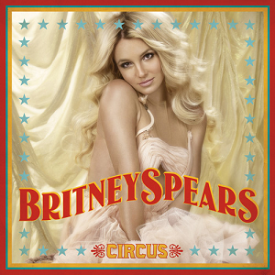
Brittany Spears - Circus
In this album cover you can see the theme of a circus is the main feature with many different elements taken into consideration. When it comes to mise en scene, you can see that they have taken a lot of time on making Spears look very angelic and giving her look that she is ‘floating’. For example her hair is bright blonde and curled just to go round her shoulders. This makes her hair look weightless and very fresh, contrasting with the light gold colour background, which also blends directly in with her hair. She is also wearing pale pink lipstick and foundation to make her skin look flawless, this is to give her a clear complexion and emphasise the ‘flawless’ look she is trying to portray. Her pale pink dress also emphasises her angelic look, this is done by showing all the ruffles under her skirt to give it a floaty look which would attract the consumers attention. When it comes to her facial expression you can see she is pulling a slight smile, whilst looking directly at the consumer. This is to engage the customer.
There is not a typical line of vision, for example the title of the album is at the bottom of the case, this is so that no attention is being taken away from Britany's face, and so this is the first thing the consumer sees when the find glance at the CD case. The name of the artist would be the second thing the consumer would see and then the name of the album, very typical to most pop album covers.
There is a lot of editing used in this album cover to give it a circus look. For Britney's name is appeared in red and yellow writing, much to what you would expect from a circus banner, it is also curved to give the impression that it is floating in the wind, once again linking back to the angelic, floaty appearance Spears is going for. The font is sans serif, the boldness makes the album stand out compared to other CD cases which maybe on the same shelf.
The lighting used is top lighting, you can see it coming down on top of her hair, this is to give her a glowing look, and also makes her look almost cartoon like.

